Slide 1
Mobile industry future and past 10 years
Introduction
Past
Future
01
02
03

Slide 2
Introduction to Mobile Industry
Notes:
Nisarg Thakkar
The mobile industry has been a transformative phenomenon, reshaping the way we communicate, access information, and conduct various aspects of our daily lives. It all began with the advent of mobile telephony, which allowed for wireless communication and freed individuals from the limitations of landline phones. However, it was the introduction of smartphones that truly revolutionized the mobile industry and propelled it to new heights.

Slide 3
Features of Mobile in Modern World
Information
Apps
Mobile devices have become powerful tools for accessing information on the go.
The mobile industry thrives on mobile applications (apps).
Shopping
Battery Life
Mobile shopping apps have made online shopping more accessible and convenient.
Battery life is a crucial aspect of mobile devices.
Sharing
Online Booking
Mobile devices have made sharing information, photos, and videos easier than ever before.
Customers can compare prices, read reviews, and make a purchase decision online.
Notes:
Information: Mobile devices have become powerful tools for accessing information on the go. With internet connectivity and search engines at our fingertips, we can quickly find answers to our queries, stay updated with news and current events, and access a vast amount of knowledge anytime, anywhere.
Shopping: The mobile industry has revolutionized the way we shop. E-commerce platforms and mobile shopping apps have made online shopping more accessible and convenient.
Sharing: Mobile devices have made sharing information, photos, and videos easier than ever before. Social media platforms and messaging apps allow users to connect with friends, family, and colleagues, and share their experiences and moments in real-time.
Apps: The mobile industry thrives on mobile applications (apps). App stores offer a vast selection of apps that cater to various needs and interests, ranging from productivity tools and entertainment apps to fitness trackers and language learning apps. Mobile apps have become an integral part of our daily lives, enhancing our productivity, entertainment, and overall mobile experience.
Battery Life: Battery life is a crucial aspect of mobile devices. As smartphones become more advanced and feature-rich, there is a constant demand for longer battery life to support the increasing usage and functionality.
Online Booking: In the current world, online platforms and e-commerce websites have made it convenient for consumers to book mobile phones online. Customers can browse through various models, compare specifications and prices, read customer reviews, and make a purchase decision online. This has eliminated the need to physically visit stores, providing convenience and a wider selection to consumers.

Slide 4
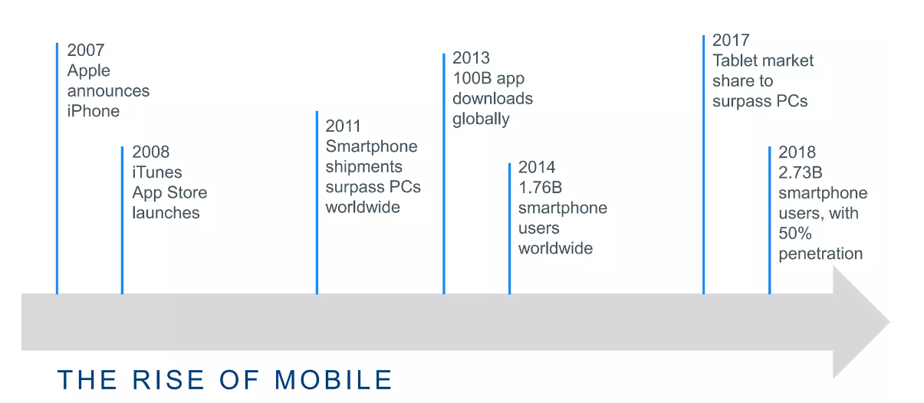
Rise of Mobile Industry

Slide 5
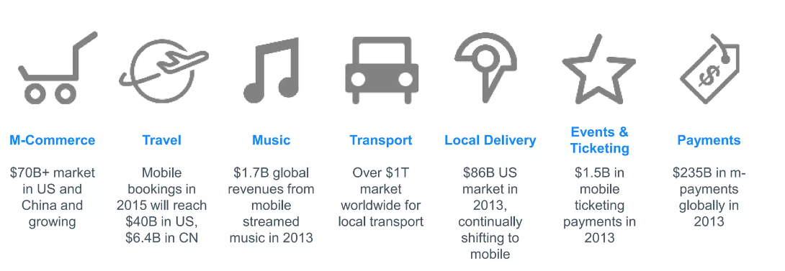
Mobile is disrupting the traditional verticials
Notes:
Mobile technology has disrupted traditional verticals across various industries, transforming the way we engage and interact. Here are some key statistics highlighting the impact of mobile in different sectors:
Mobile commerce: Global mobile retail sales to reach $3.56 trillion by 2021.
Travel: Over 70% of travel bookings made on mobile devices.
Music: Mobile devices account for over 60% of global music streaming.
Transport: Global ride-hailing market projected to reach $183.7 billion by 2028.
Local Delivery: Global food delivery market to reach $126.91 billion by 2025.
Event and Ticketing: Mobile ticket sales accounted for 44% of all event ticket sales in the US in 2020.
Payments: Mobile payment transaction value to surpass $14 trillion globally by 2023.

Slide 6
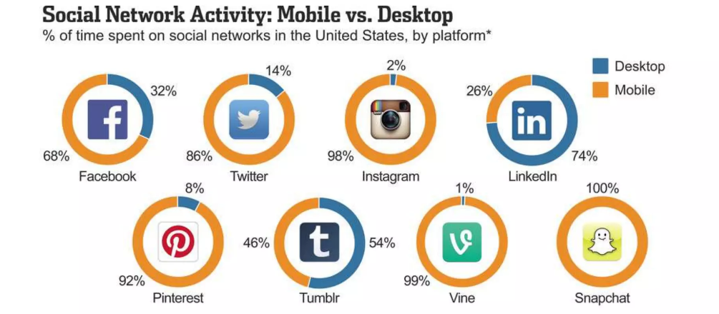
Mobile and Social Media go Hand-in-Hand
Notes:
Mobile devices have significantly influenced the way people interact with social media platforms like Facebook, Instagram, and Snapchat. Here are some key points about the time spent on these platforms on mobile compared to desktop:
Facebook: Mobile Usage: Facebook has experienced a significant shift towards mobile usage, with around 98% of its daily active users accessing the platform through mobile devices.
Time Spent: On average, Facebook users spend approximately 34 minutes per day on the mobile app, compared to 29 minutes on desktop.
Instagram: Mobile Usage: Instagram is predominantly a mobile-based platform, with a highly engaging mobile app tailored for sharing visual content.
Time Spent: Users spend an average of 53 minutes per day on the Instagram app, significantly higher than the time spent on the desktop version.
Snapchat:Mobile Usage: Snapchat is known for its mobile-first approach, where the majority of its features and content are optimized for mobile devices.
Time Spent: Users typically spend around 30 minutes per day on the Snapchat app, primarily on their mobile phones, engaging with photos, videos, and augmented reality filters.
Overall, mobile devices have become the primary means of accessing and engaging with social media platforms. The convenience, portability, and intuitive interfaces of mobile apps have contributed to increased user engagement and longer time spent on these platforms compared to desktop usage. Mobile and social media are closely intertwined, with mobile devices playing a pivotal role in shaping how we connect, communicate, and consume content on social media.

Slide 7
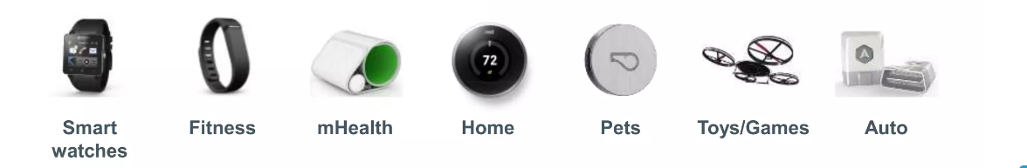
Mobile makes it possible to connect everything
20B
Connected devices expected by 2024

Slide 8
SWOT Analysis
Strength
Weakness
India is the 2nd largest mobile market after china. Easier to create economies of scale .
It is difficult to enter because of the requirement of high financial resources The country has a low manufacturing base .
Opportunities
Threats
Upcoming 5G technology. Rising data consumption.
Heavy competition between the top players Virus and malware attacks.
Notes:
SWAT
1.Strength: India is the 2nd largest mobile market after china . • The revenue of indian mobile industry is rising at booming speed . • It has a large customer base due to it’s huge population . • Easier to create economies of scale . • Increases returns on investment . • Supported by government with many schemes .
2. Weakness: • The company has poor telecommunication infrastructure resulting in large call drops . • It is difficult to enter because of the requirement of high financial resources . • The country has a low manufacturing base . • High resolution levels that affects the health .
3. Opportunities: Upcoming 5G technology. • Rising data consumption. • Customers interest towards new technologies. • Growing rural numbers. • Rising disposable income.
4. Threats: • Heavy competition between the top players . • Virus and malware attacks. • Partiality of the government . ex: allowing 3G services in a PSU (MTNL , BSNL) before auctioning to the private players . • Declining ARPU ( Average Revenue Per User) .

Slide 9
Past of mobile industry
The First Cellular Networks
2G/GSM Networks
3G
4G
Notes:
Explain the stack of Internet
1G completely publish in 1990 after then

Slide 10
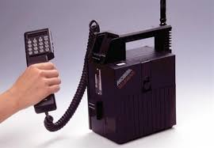
The First Cellular Networks
Notes:
Starting from simple wireless analog-based (1G) portable phones, it wasn’t until the late 1990’s that cell phones turned into more sophisticated devices as the technology inside them started to spawn an ever larger number of features (features that nonetheless seem basic by today’s standards). These first phones gave basic calling abilities to users and their convenient portable capacities are what established them as widely-used communications devices.

Slide 11
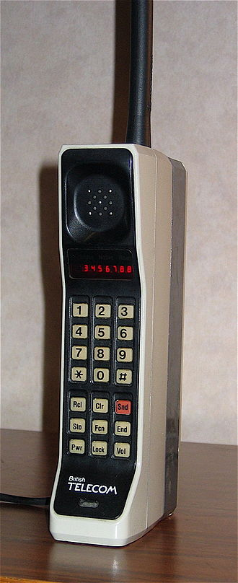
DynaTAC 8000X
1.1 kg
3995$
Weight
Price
30
9.1x5.1x1.8
Size in inches
Talk time in minutes
10
30
Hours to recharge
Phone number storage
Notes:
The first portable cell phone was invented in 1973 by Motorola. On April 3, 1973, Motorola engineer Martin Cooper made the first-ever cell phone call on the DynaTAC 8000X. The prototype he used weighed 2.4 lb (1.1 kg) and measured 9.1 x 5.1 x 1.8 in (23 x 13 x 4.5 cm). This clunky device offered a talk time of just 30 minutes and required 10 hours to recharge. Before this, owning a car phone was the closest that one could get to not being tied to a landline.
The DynaTAC phone was priced at $3,995, equivalent to $10,000 today.

Slide 12
Early History
1985
1987
1988
1989
The first Siemens phone
The first Samsung phone
The first flip phone
The first Nokia phone
01
02
03
04
Notes:
The first Siemens phone
The first Siemens mobile phone was the Siemens Mobiltelefon C1, which came in the form of a suitcase. Yes, you read that right. People had a cell phone that was actually a suitcase. After that, some more compact phones followed.
The first Nokia phone
In 1987, Nokia launched its first mobile phone, the Mobira Cityman 900. The phone weighed only 800g (28 oz) including the battery, and was considered expensive and exclusive to those of a higher status.
The first Samsung phone
A year later, in 1988, Samsung developed its first “handphone" — The SH-100. It was officially the first mobile phone to be designed and manufactured in Korea.
The first flip phone
After many similar brick-style cell phones, Motorola innovated again by bringing the "flip" design to the market. Before Motorola’s MicroTAC model, most cell phones were bulky and usually installed in cars due to their size

Slide 13
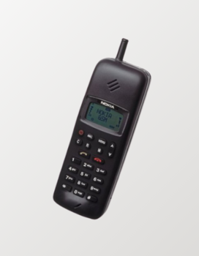
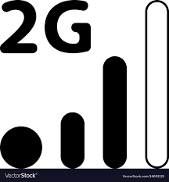
2G/GSM networks
Notes:
It wasn’t until the mid to late 1990’s that a new communications network, known as GSM—or 2G, as it was less often called—began to develop in which more mobile services could be offered. At this point, the first pre-smartphone devices began to appear, and the fact that data transmission over these next-generation devices was digital instead of analog allowed them to carry many of the more basic smartphone features that we use as the basis for modern app development. Capabilities such as text messaging, downloadable content, and extremely basic web access gave consumers the ability to send emails, view a small selection of online multimedia, and download simple digital applications such as ringtones and music files.
The growth of the GSM, or 2G networks, is what really expanded mobile phone use so broadly that mobile devices eventually eclipsed landline communication tools. Despite the 2G networks explosive popularity amongst users of all income levels worldwide, these machines were still pretty basic compared to today’s mobile devices.
The first GSM (2G) phone
As we moved into the 90s, phone bodies became smaller and the antennas thinner. In 1992, the next big innovation came in the form of the Nokia 1011, which was the first mass-produced GSM (2G) phone.

Slide 14
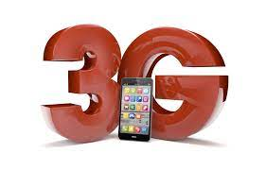
Notes:
It wasn’t until the early 2000’s, with the development and service offering of the first 3G wireless digital networks that true smartphones arrived. In 2002 and 2003, network operators began to offer widespread 3G access based on more powerful wireless transmission technology that depended on efficient packet switching data transmission found in computer-based web connections instead of the 2G networks circuit switching mechanism.
With the arrival and rise of 3G, the modern era of wireless mobile smartphones as pocket-sized computers truly began, especially after 2005, when High-Speed Downlink Packet Access (HSDPA) was implemented into 3G and expanded its data carrying ability even more. The resulting explosion in online media accessibility created a tandem explosion in online media creation. At the same time, in order to take full advantage of all these web-based data options that phone networks now offered, mobile applications started appearing for smart phones—at first in small quantities but later at a rapid development pace. Also, the devices themselves had to be redesigned so that they could better display digital media and other interactive systems, taking full advantage of the growing apps market.

Slide 15
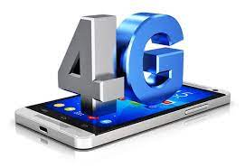
Notes:
Currently, even 3G itself is being slowly replaced by the much more powerful, purely packet-switching-based, data optimized 4G network. With this new technology, ten-fold increases over 3G in data transmission ability are coming into the picture, making access to digital media even more robust and further bolstering the demand for media-rich mobile applications.

Slide 16
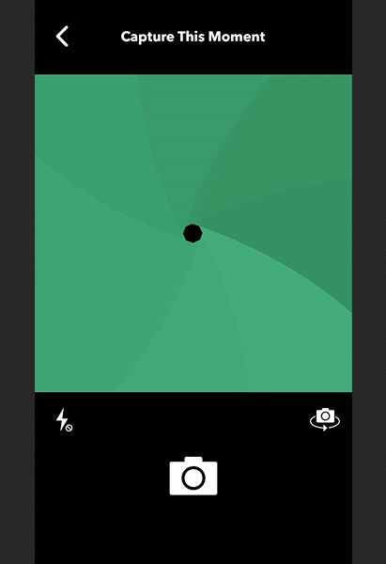
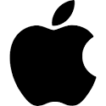
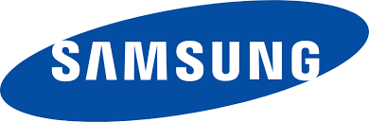
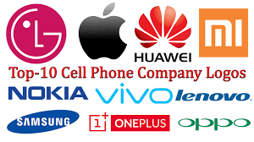

Past 10 years

Slide 17
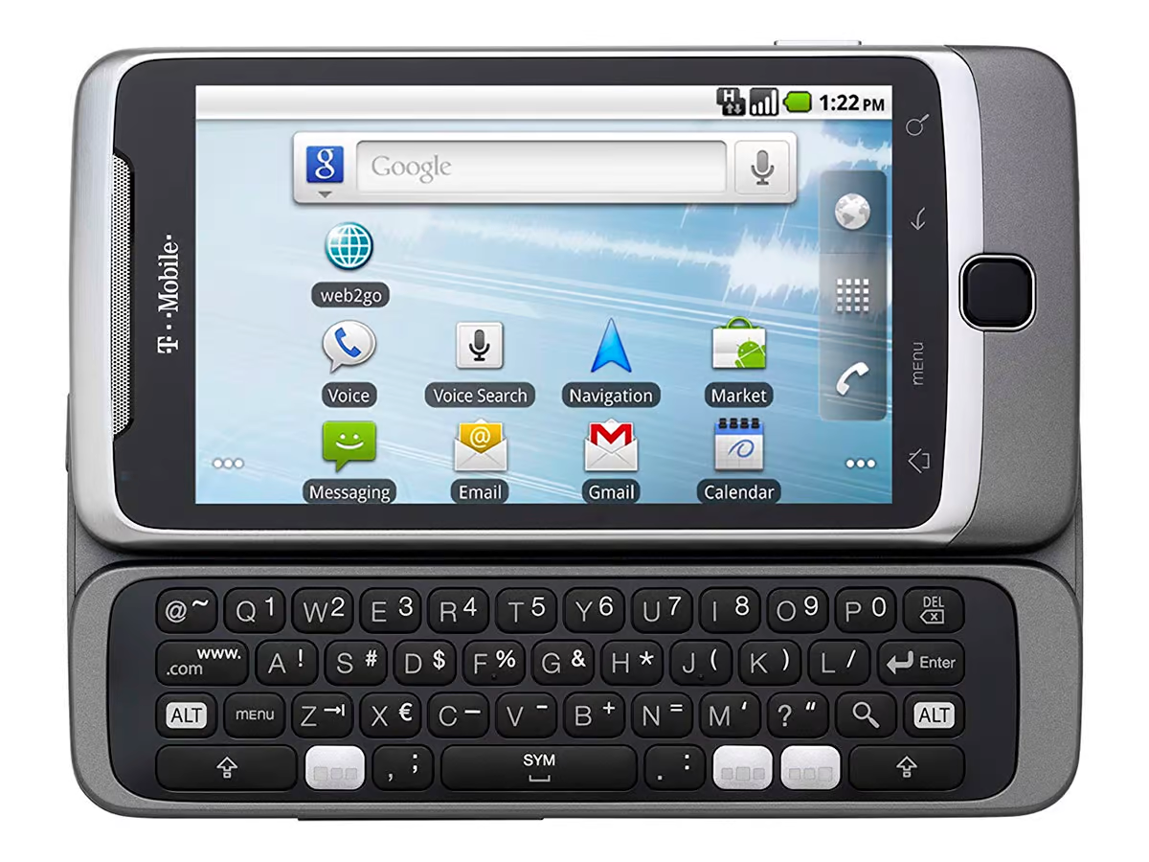
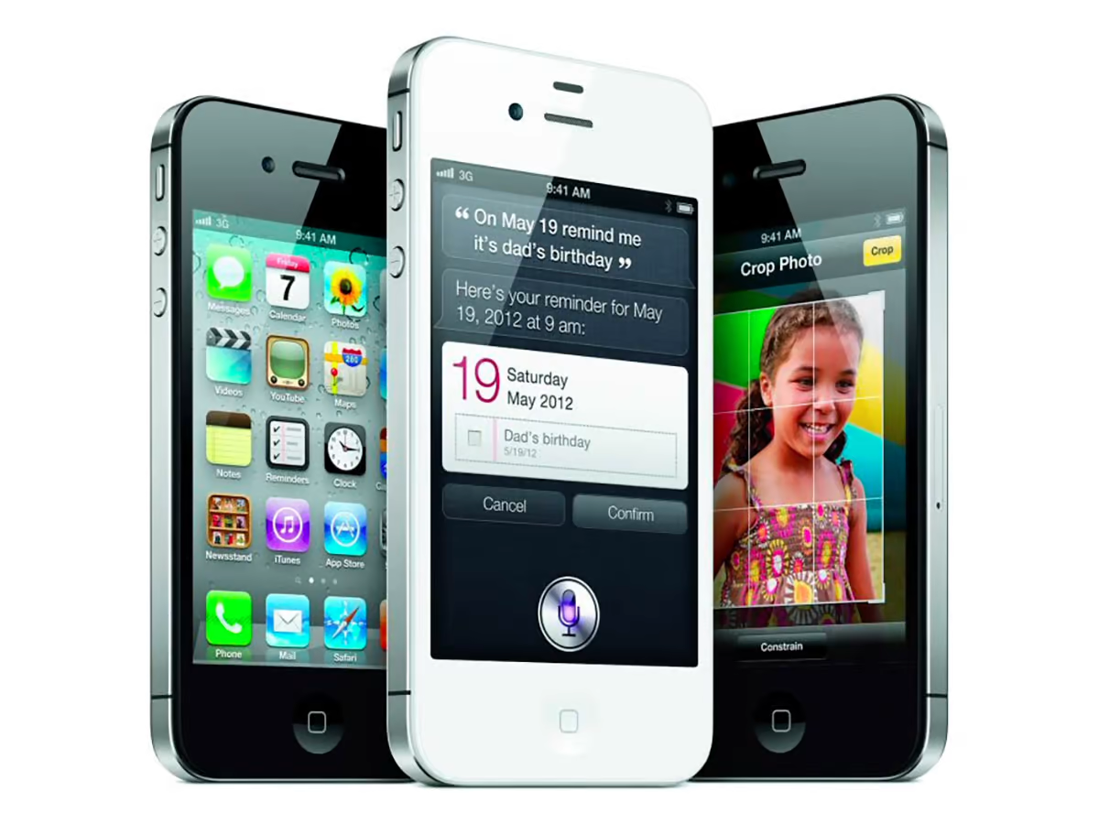
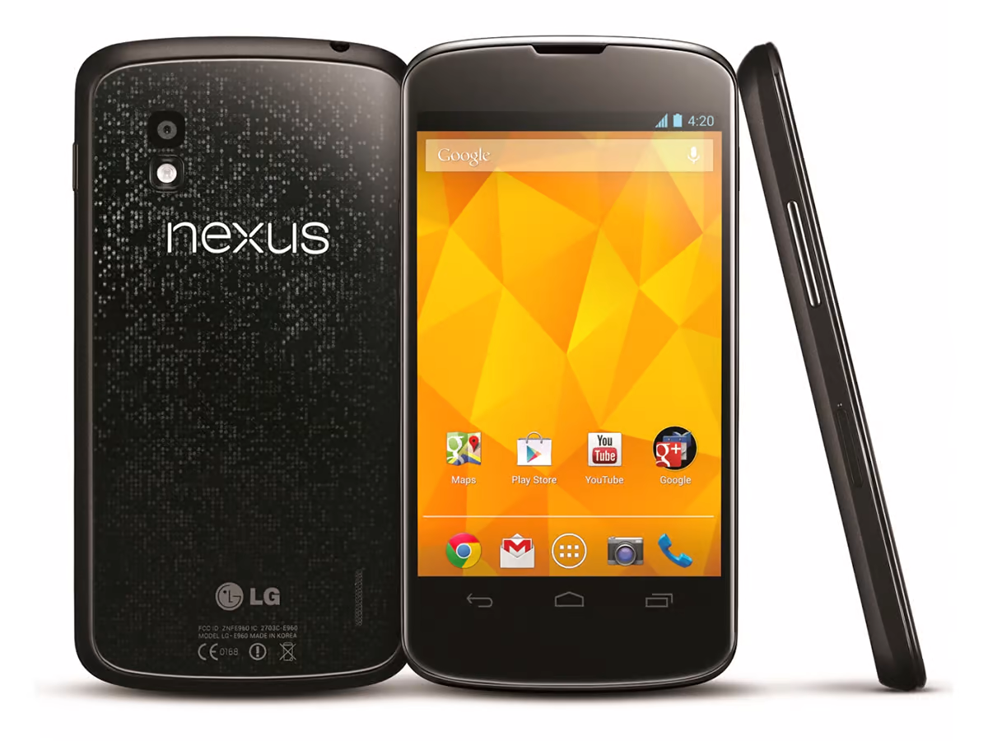
2010
2011
2012
The T-Mobile G2 and a very early version of Android
The Nexus 4 was a collaboration between Google and LG
The small but perfectly formed iPhone 4S

Slide 18
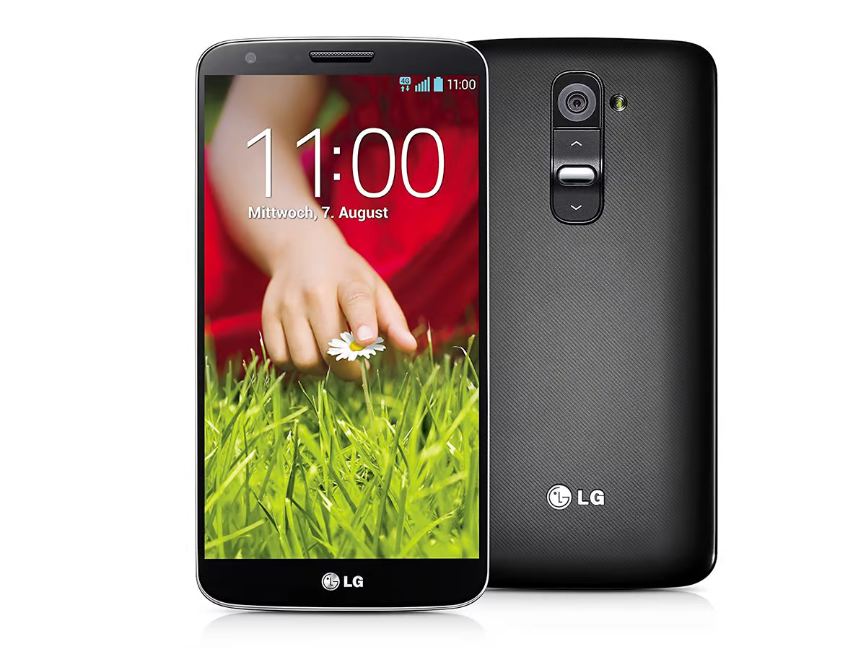
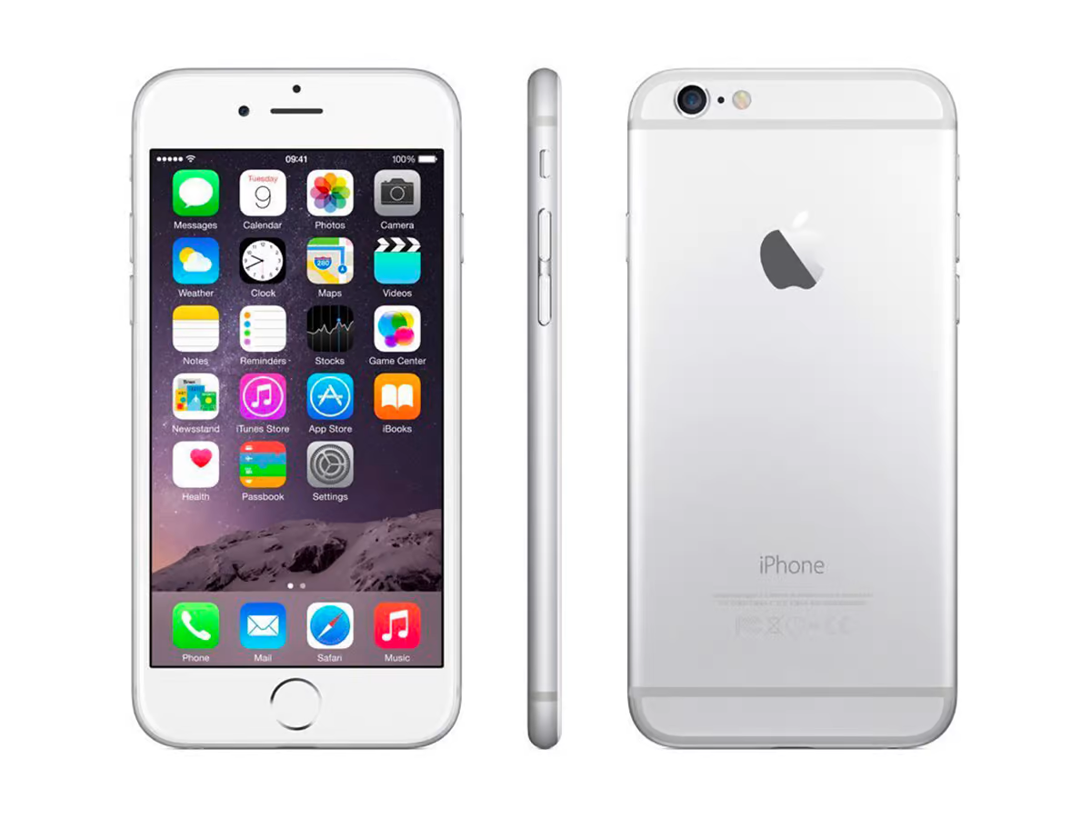
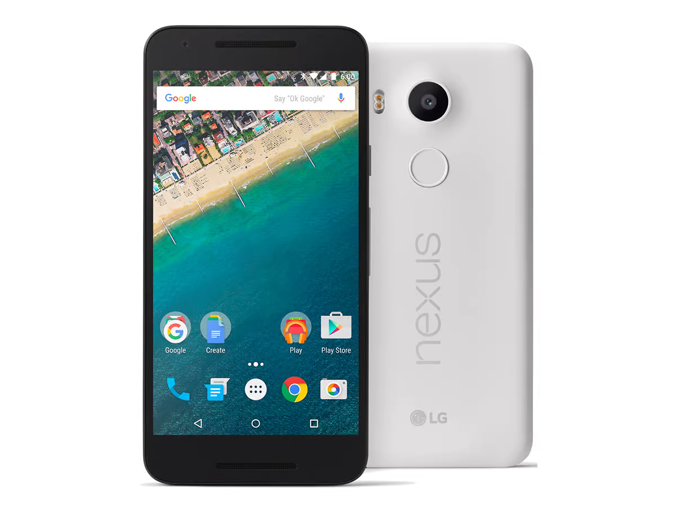
2013
2014
2015
With a 5.2-inch display, the LG G2 was large for its time
The iPhone 6 showed off another classic Apple design
In 2015, Google brought out both the Nexus 5X and the Nexus 6P

Slide 19
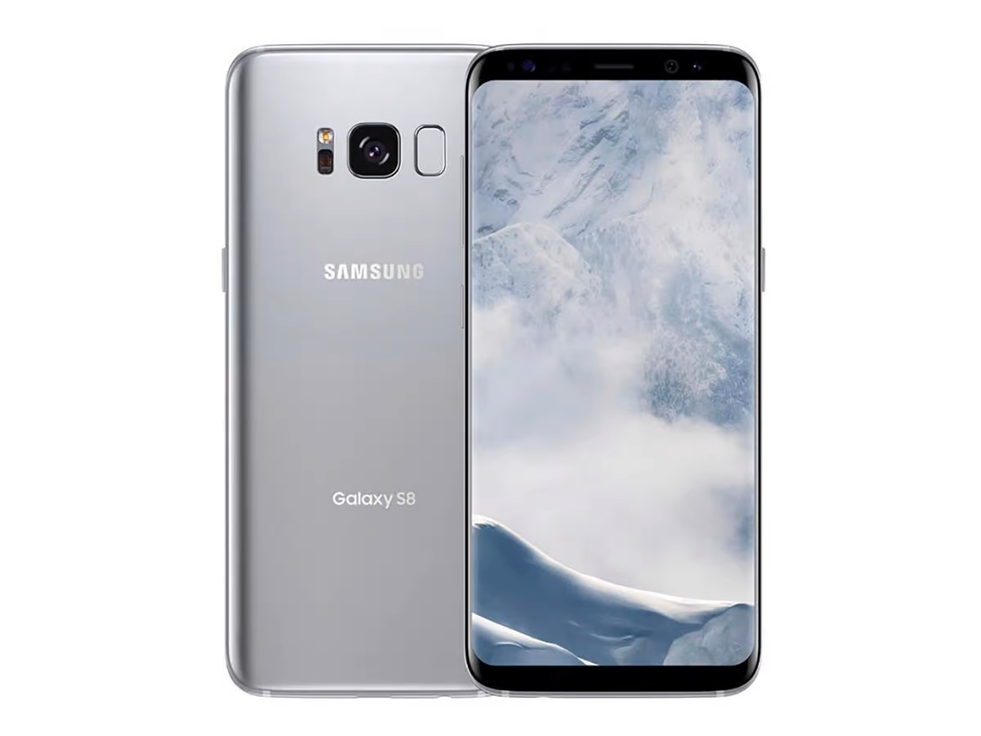
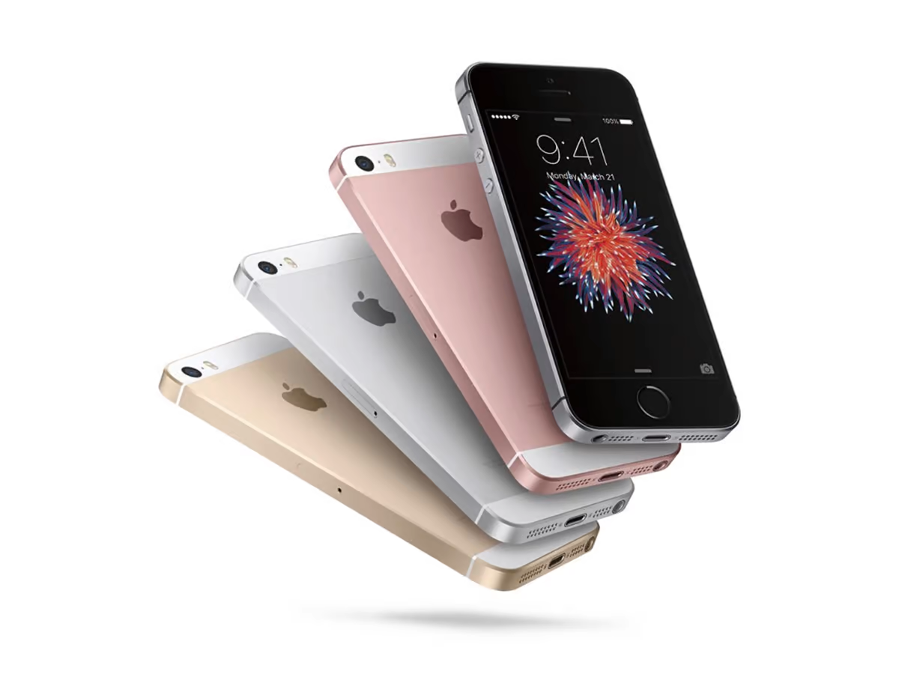
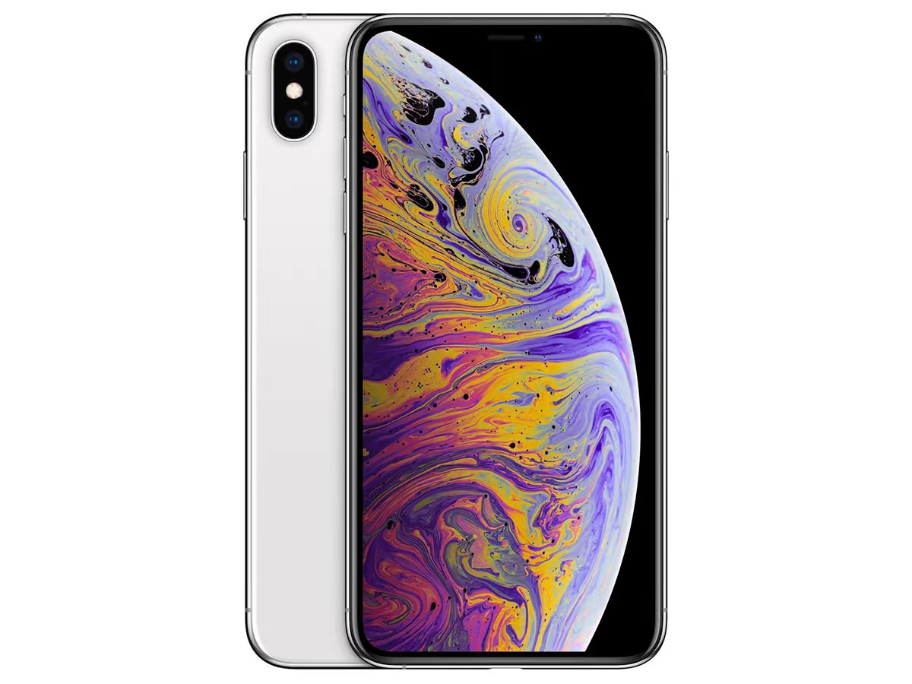
2016
2017
2018
The Galaxy style has evolved down the years, as the Galaxy S8 shows
Design-wise, the iPhone XS looked similar to the iPhone X
The iPhone SE launched in 2016 but was a throwback to an earlier iPhone time

Slide 20
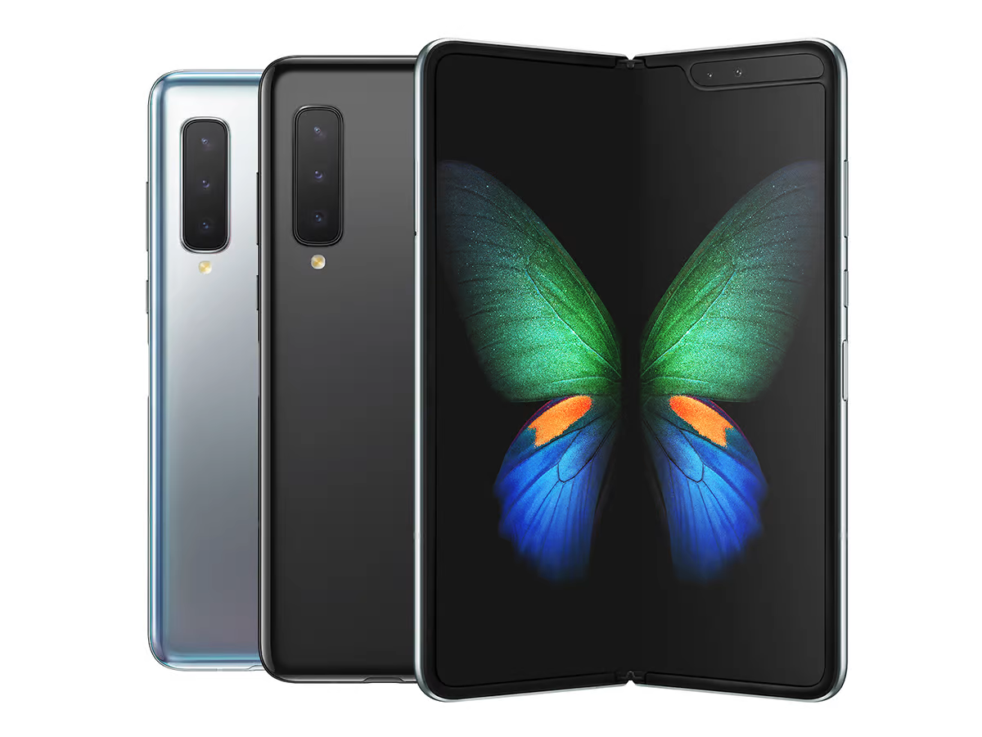
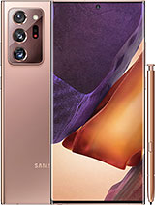
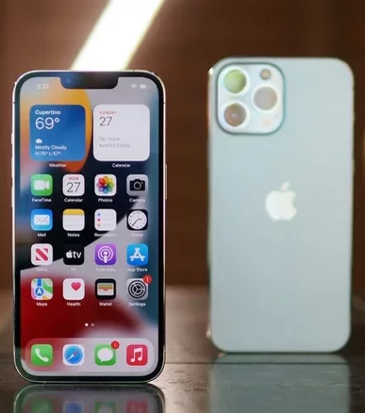
2019
2020
2021
The new Samsung Galaxy Note 20 Ultra is supposed to be the best of the best that Samsung has to offer in a smartphone – minus a bendable screen.
the most advanced camera system in the non-pro family, with extensive image processing for sharper details, per Apple.
Foldable phones like the Galaxy Fold are now a reality in 2019

Slide 21
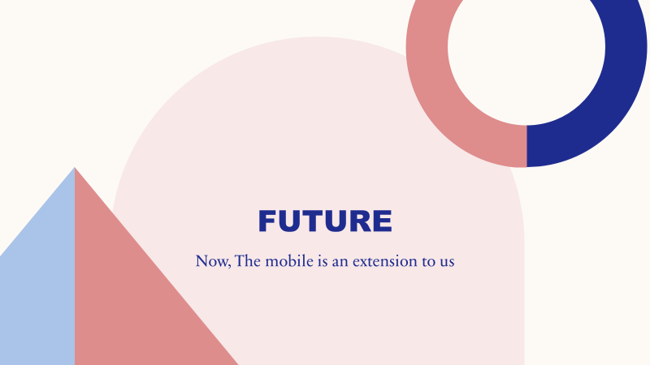

Slide 22

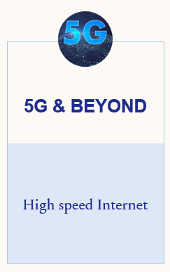
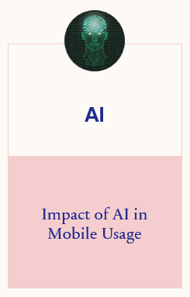
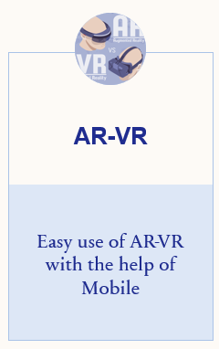
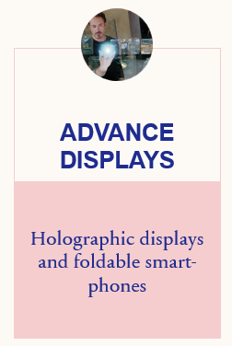
Technologies that can impact Mobile industry

Slide 23
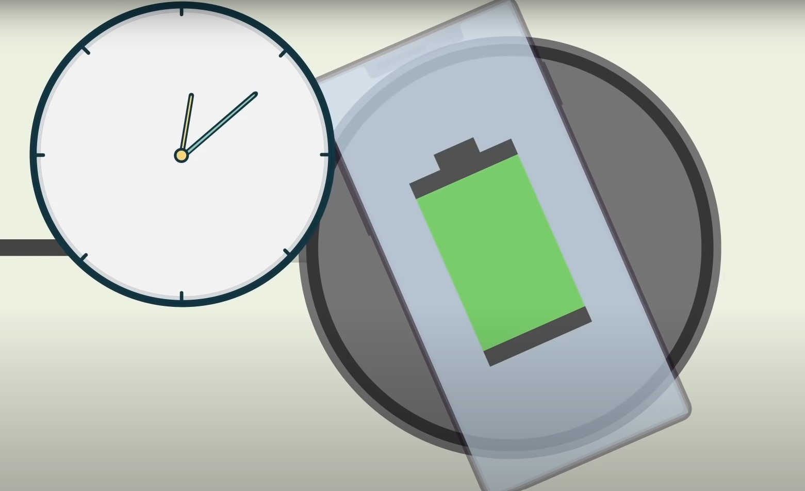
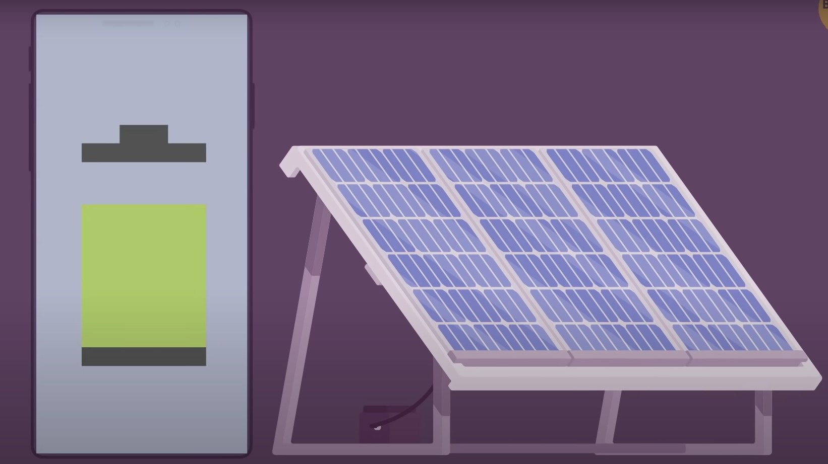
Quick Charge
Over The Air Charging
Tesla Model PI

Slide 24
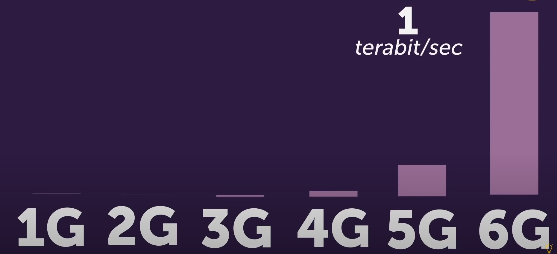
5G & Beyond
5G with peak data rate of 20 Gbps and 100+ Mbps of average data rates
6G with peak data rate of 1 Tbps

Slide 25
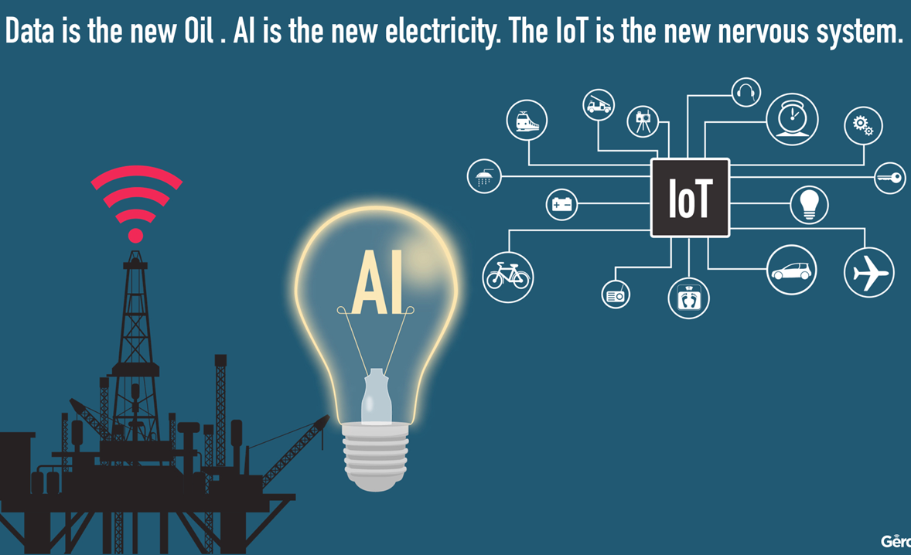
Impact of AI and IOT

Slide 26
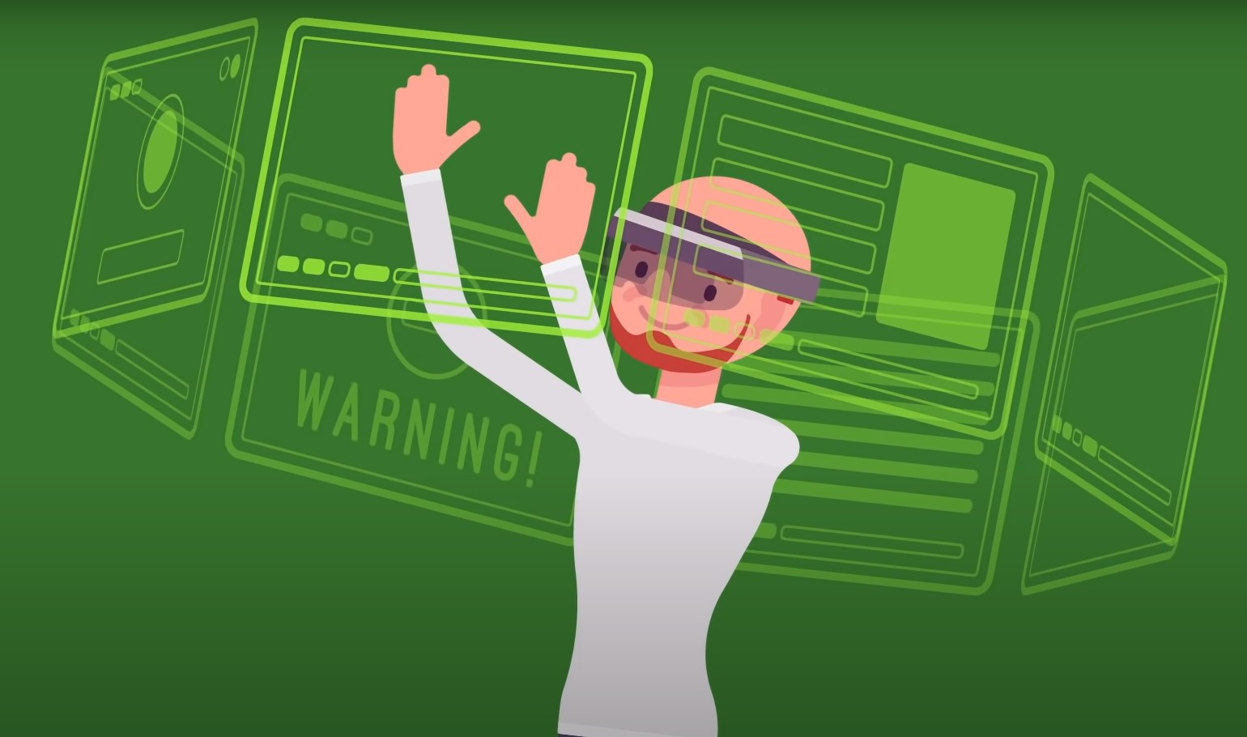
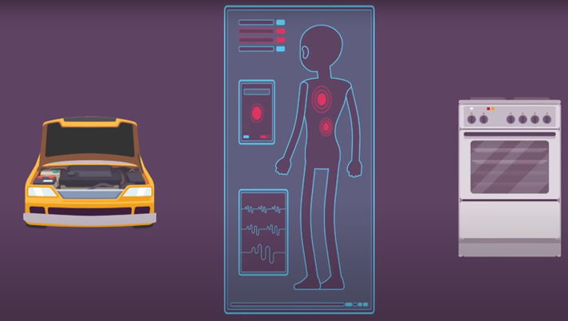
AR-VR
VR will enhance user experience drastically
AR & AI enabled smartphones will help us to solve problems, make suggestions like interior, cloths, etc.

Slide 27
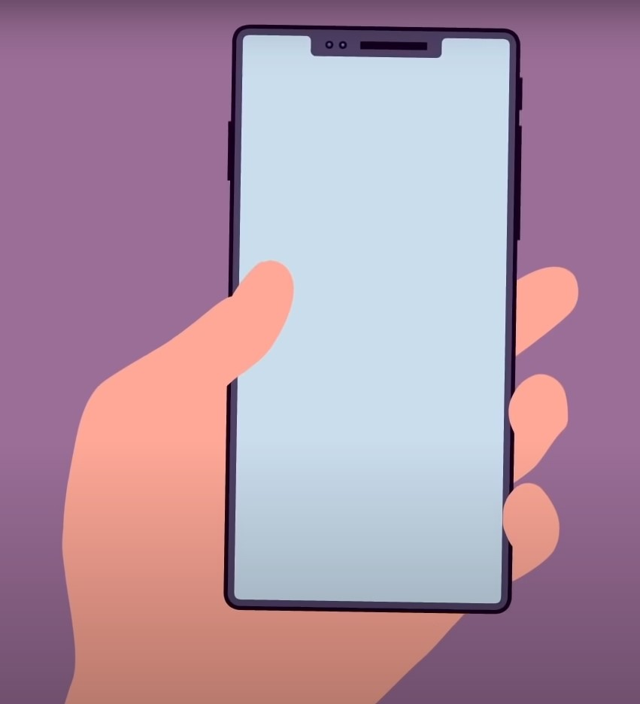
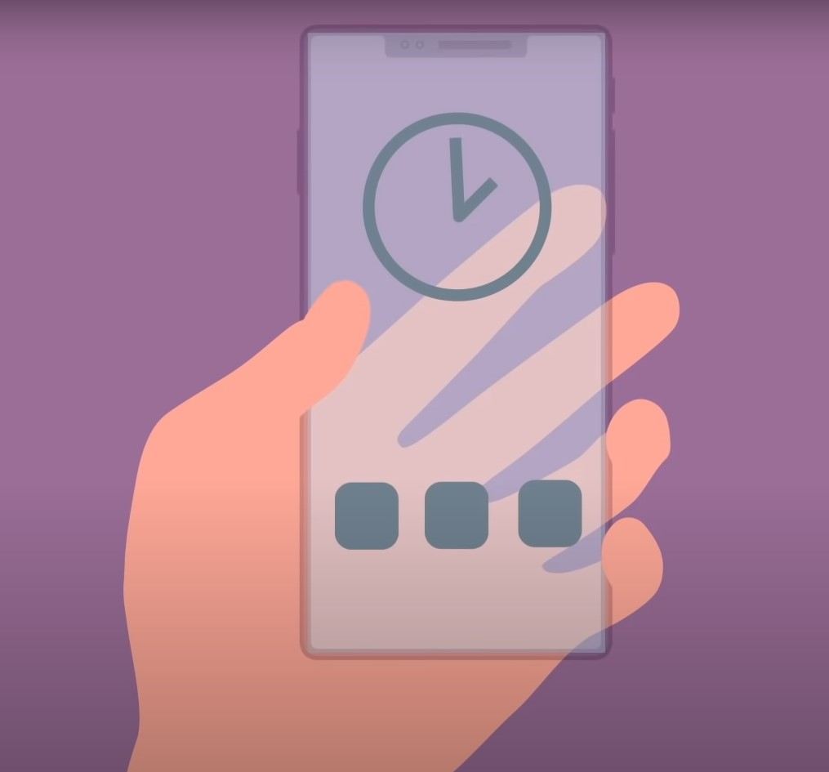
Feel of smartphones
Current displays
Transparent & Portless Smartphones

Slide 28
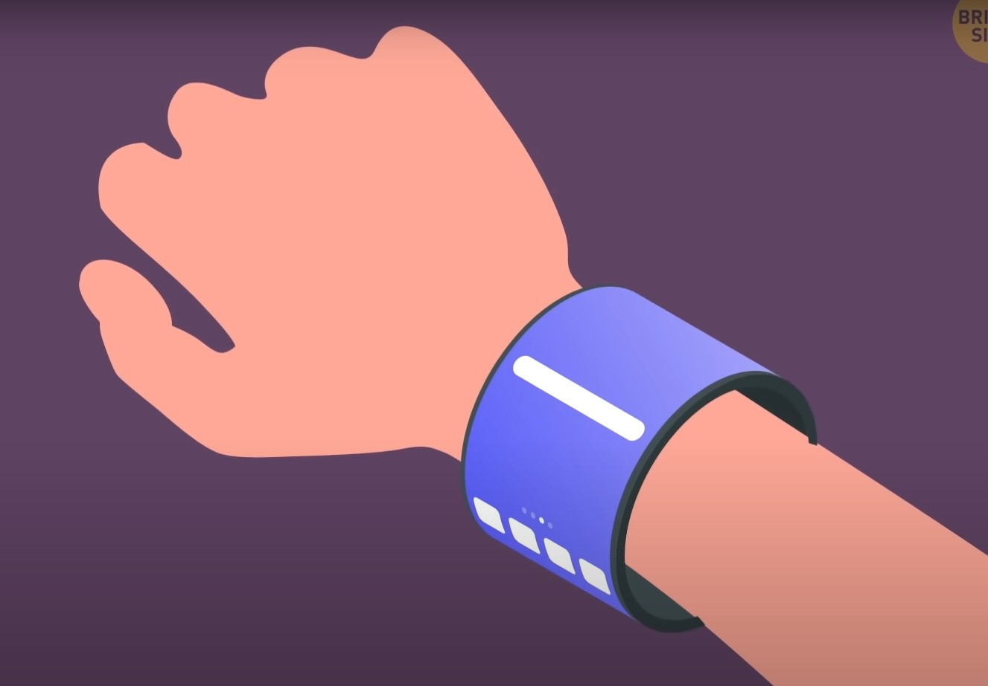
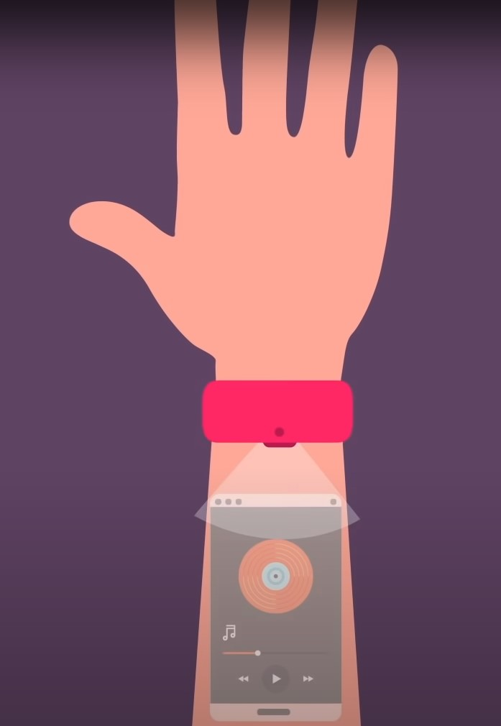

Advance Displays
Foldable Displays
Holographic Displays

Slide 29
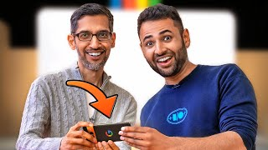
Summary

Slide 30


